Slide 1

Sensory Trail in Urban Park
Fairview Urban Park | Montgomery Parks
January 2023

Slide 2
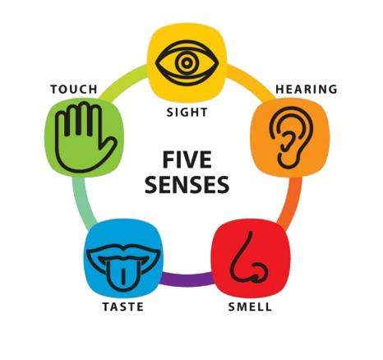
What is a Sensory Trail
Sensory Trails
  Appeals to all senses:
  touch, taste, sight, hearing, smell
  Serves people with visual impairments​
  “Sensory-Friendly” may also apply to facilities for people with autism​
Accessible Trails
  Serves wheelchair users/mobility-impaired people​
  All sensory trails are accessible

Slide 3
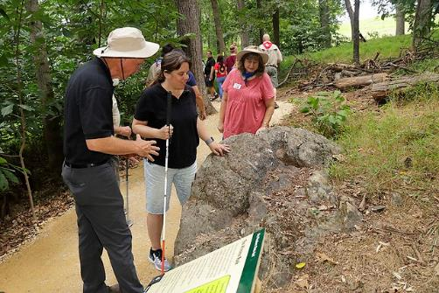
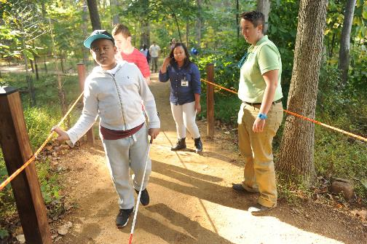
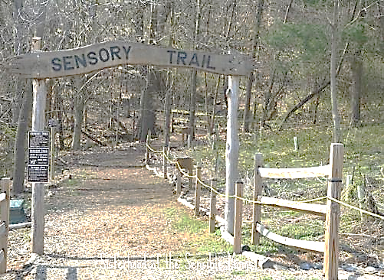
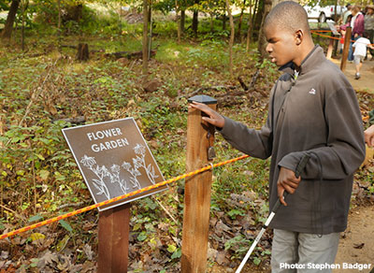
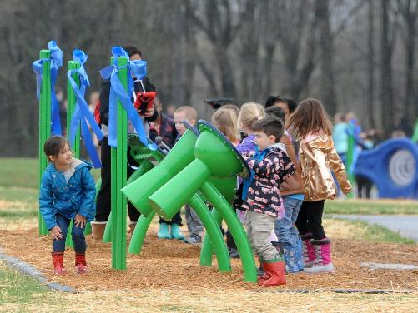
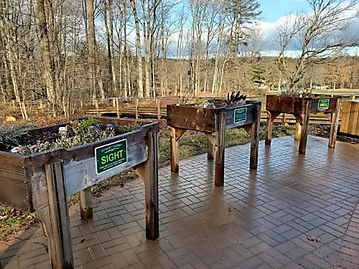
Sensory Trails in the Region
Catoctin Creek park (0.2 miles) – Fredrick County
Patapsco State Park (0.1 miles) – Howard County
Schucks Regional Park (0.1 miles) – Harford County
Watchung Reservation Sensory Trail (0.3 miles)– New Jersey
Sky Meadows State Park- Virginia
Notes:
Many different trails in different counties and states, Each is built differently. Most of these sensory trails are located in more rural and wooded areas.
None in Montgomery Parks. we want your opinion and ideas on what would be preferred.

Slide 4

Why a sensory trail in an urban park
Convenient
Awareness
Multiple Options
Already Utilized
Notes:
Understanding there are challenges such as parking and noises that are not ideal for a sensory trail, why is a sensory trail proposed in an urban park?
Convenient – down town silver spring, Close proximity to community amenities and public transportation, via public transportation, walking, connector trail
Awareness – brings awareness to this specific community and needs of people with disabilities?
Multiple options at this specific park, woods or grass, natural or artificial
Utilized- Columbia Lighthouse for the Blind already permits this park for events such as easter egg hunts

Slide 5
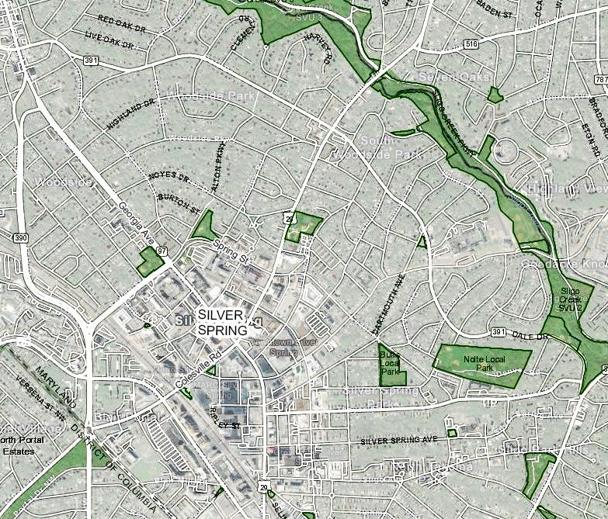
Site Location
0.5 miles
Fairview Urban Park
Silver Spring Downtown
Close to offices, other urban parks, restaurants, etc
Potential connection to Sligo Creek Trail (10 mins walk)
Fairview Urban Park
Ellsworth Urban Park
Woodside Urban Park

Slide 6
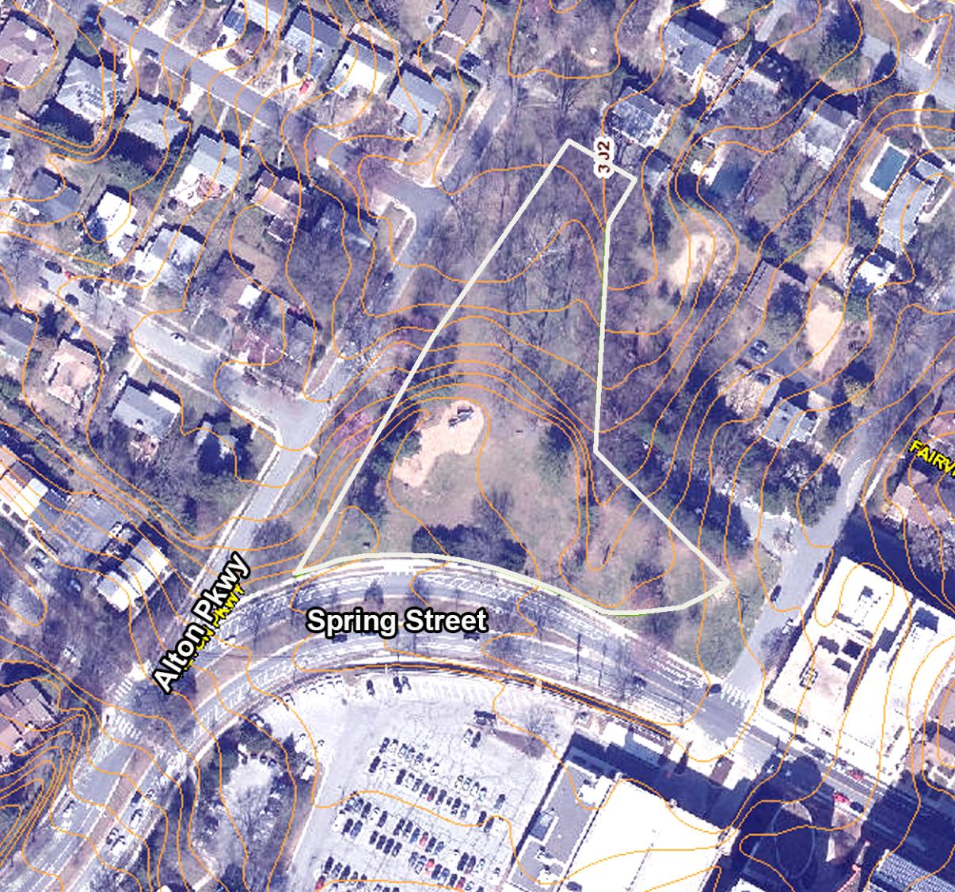
Existing
Conditions
Lower
Area
(Wooded)
Upper Area with open lawn area and a playground
Lower wooded area
Approximately 6’ of elevation change
Approx. 6’ elevation change
Upper Area
(Open Lawn Area
With Playground)

Slide 7
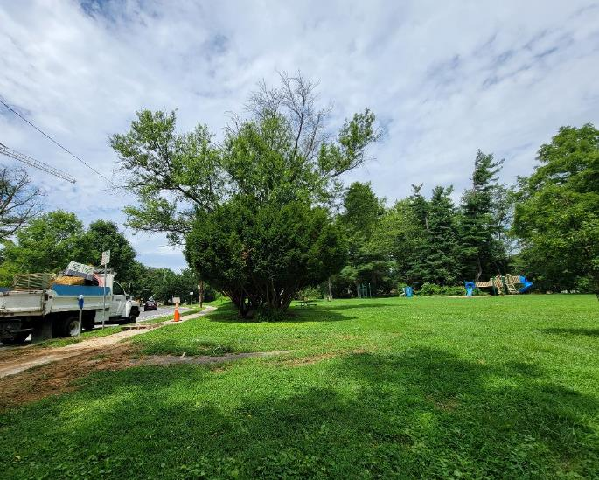
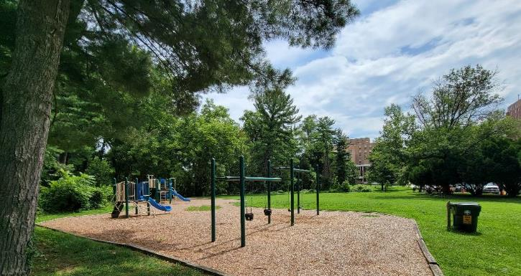
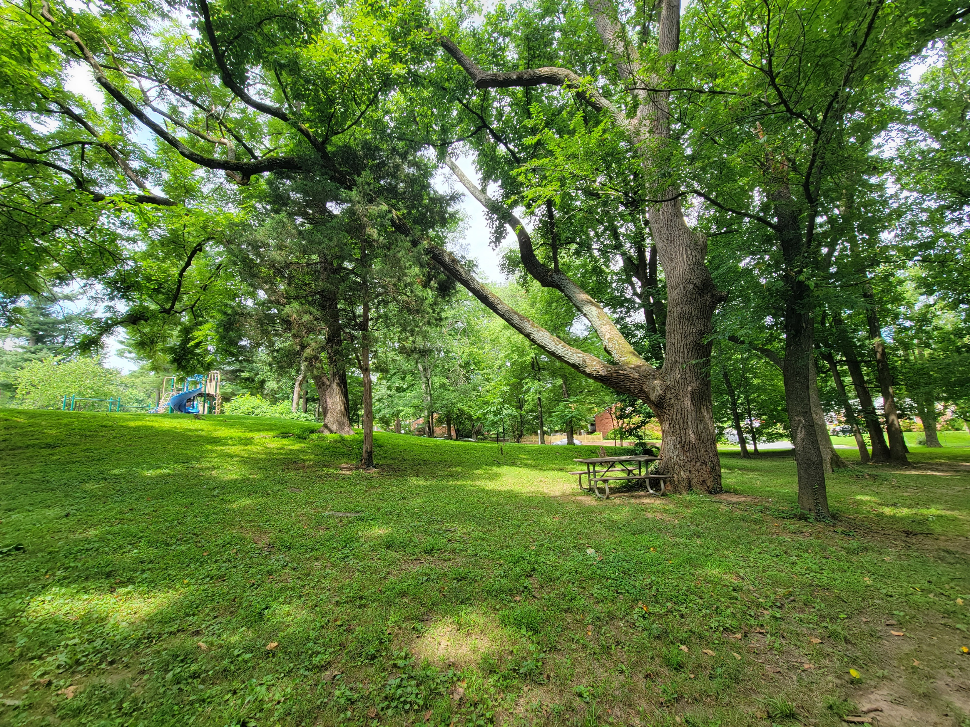
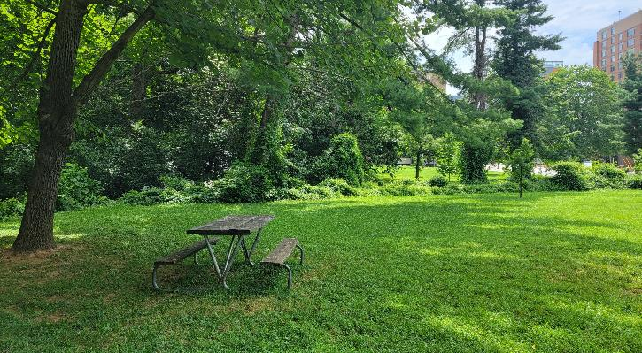
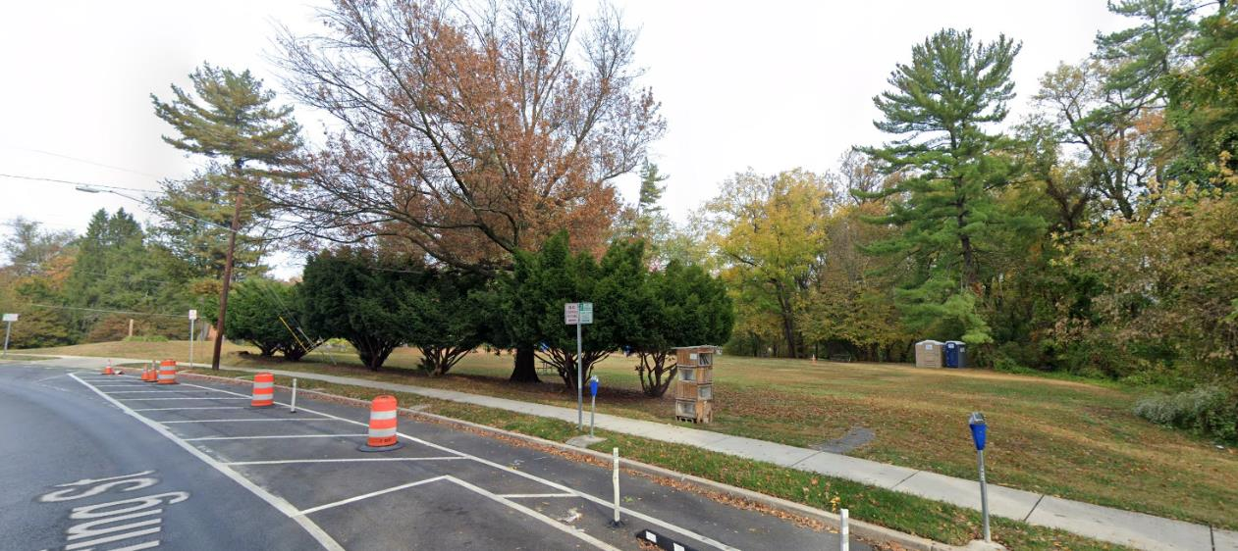
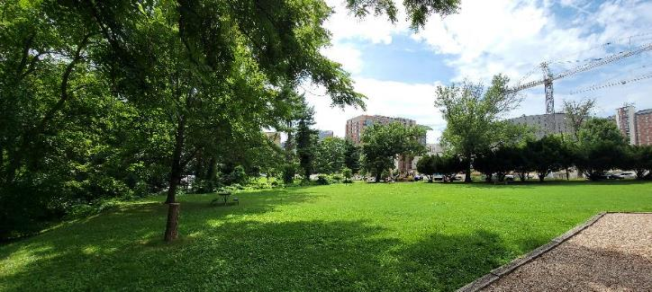
Existing Photos
Notes:
Lower right photo can see the grading drop on the left towards the wooded area

Slide 8
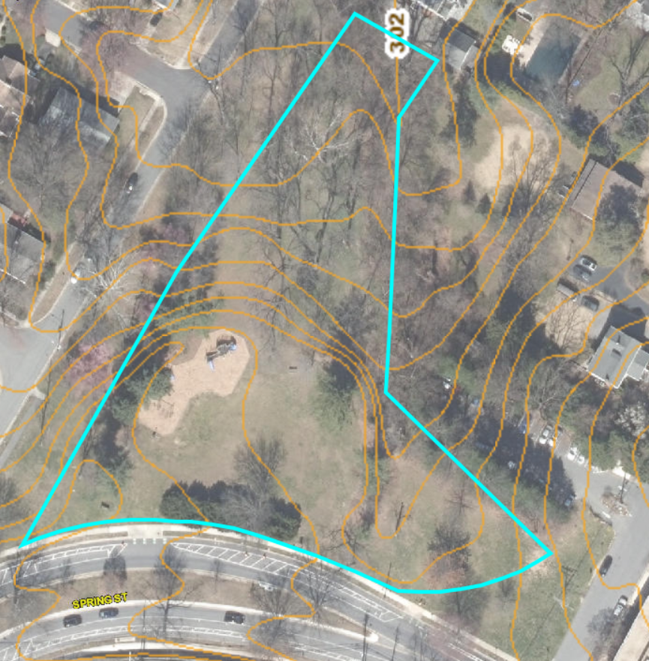
Proposed Sensory Trail
Close to the park entrance and playground
Great visibility
0.1-mile natural surface trail inside the park
Maintain the open lawn area for public events
3
2
4
Park Entrance
Proposed multi-use trail
Sidewalk along Spring St.
Sensory Trail
Sensory Trail Stations
1
5
1
Notes:
Keep the open lawn for any public activities. Trail will be at the perimeter of the lawn.
with the potential of a loop path incorporating the existing sidewalk along Spring Street

Slide 9
Alternative Trail Location
Close to the park entrance and playground
Great visibility
0.1-mile hard surface trail inside the park
Maintain the open lawn area for public events
3
2
4
Park Entrance Trees
Proposed multi-use trail
Sidewalk along Spring St.
Sensory Trail
Sensory Trail Stations
1
5
1
Notes:
Keep the open lawn for any public activities. Trail will be at the perimeter of the lawn.
with the potential of a loop path incorporating the existing sidewalk along Spring Street

Slide 10
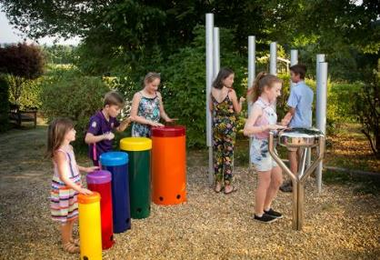
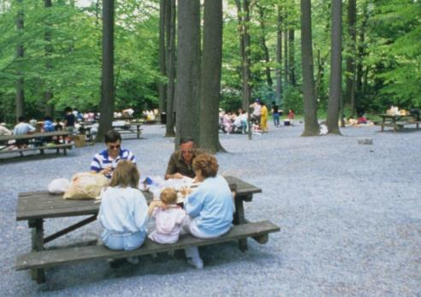
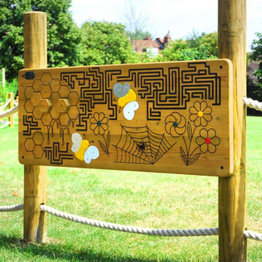
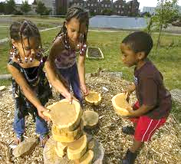
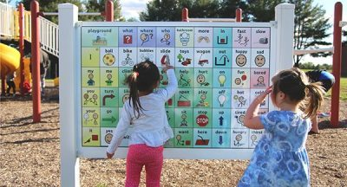
Sensory Station Ideas
-Active Stations
Playground
Activity Panels
Makerspace
Gathering Place
Music Station

Slide 11
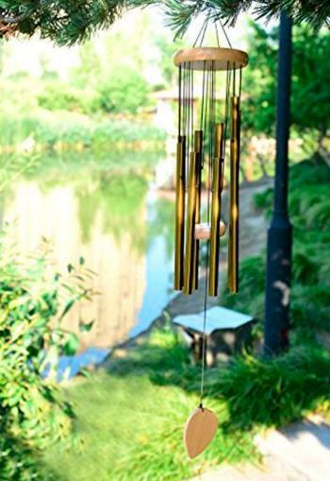

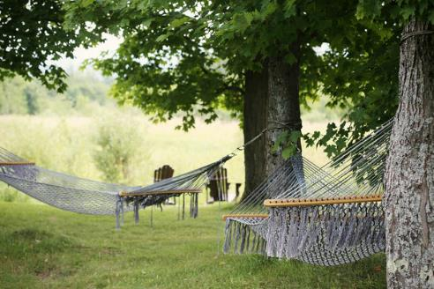
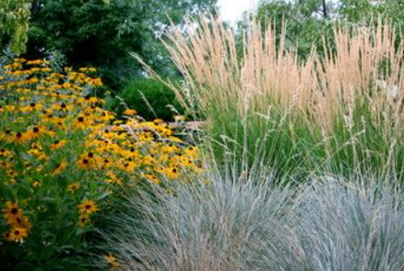
Sensory Station Ideas
- Passive Stations
Overlook with lawn chairs
Wind Chime Grove
Hammock Grove
Flowers and Grasses

Slide 12
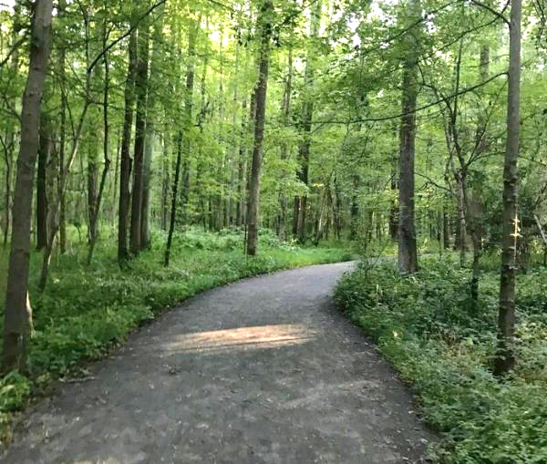
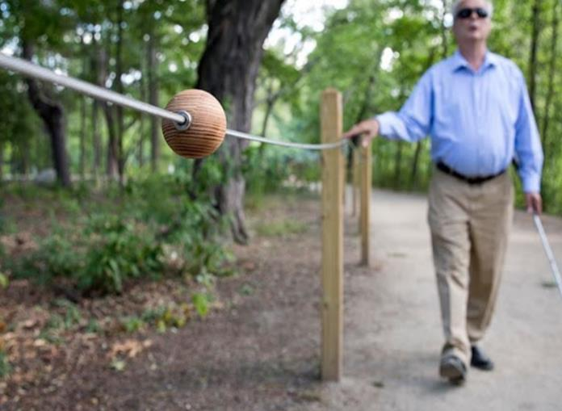
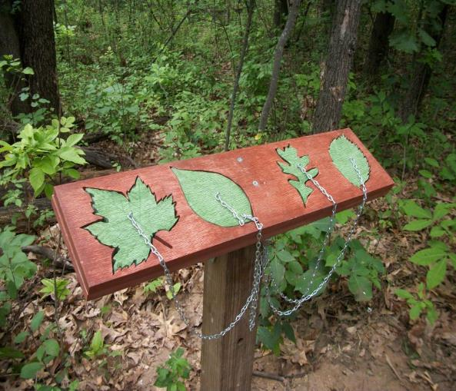
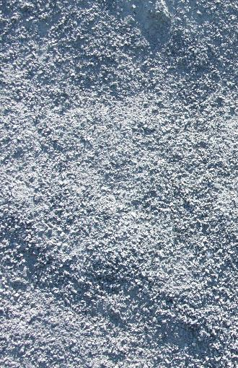
Sensory Trail Construction
Materials:
Blue Dust
Way finding:
Ropes and bells
Tactile signs

Slide 13
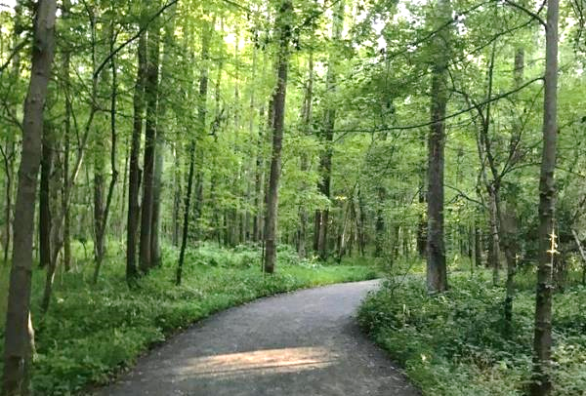

Trail Surface Materials
Blue dust
Compact and smooth surface
Allows water to filtrate

Slide 14
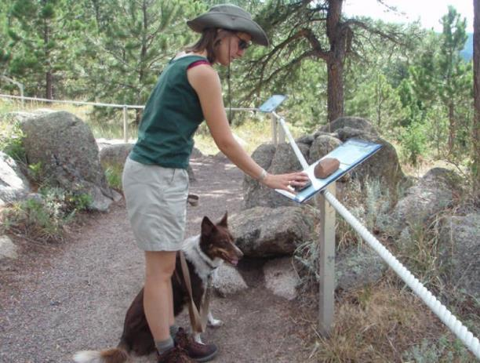

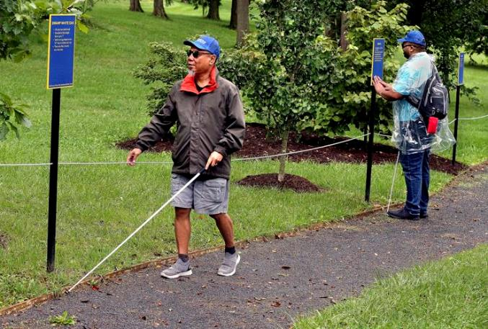
Wayfinding devices
Ropes
Bells
Pavement edgings
Signage

Slide 15
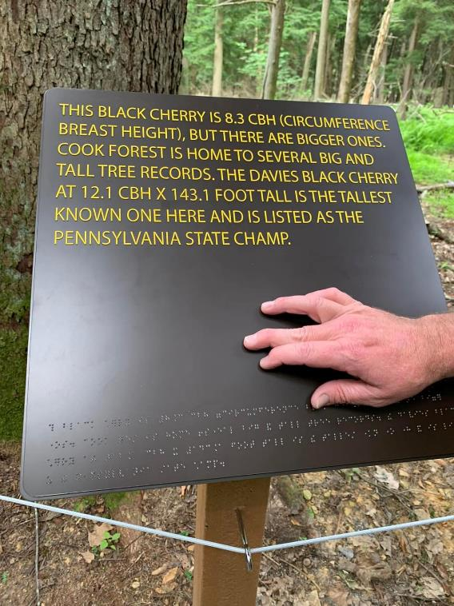
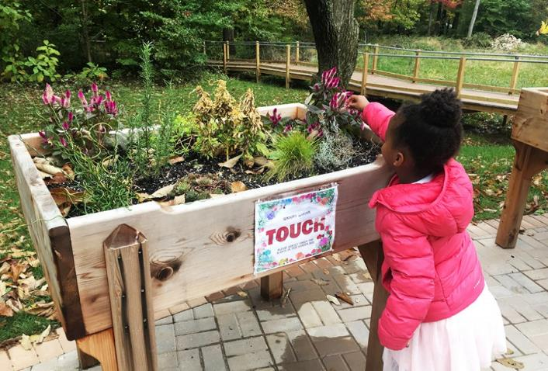
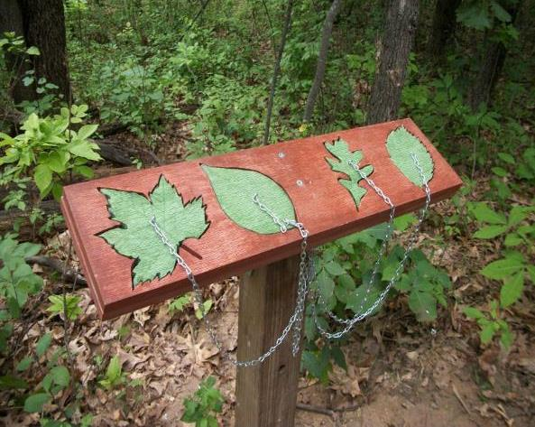
Tactile Signs
Tactile signs
Shapes
Touchable Materials

Slide 16

Next Step
Public Survey and Comment
Budget
Detailed Design
Construction
Notes:
Next step:
Survey will be posted on Open Town Hall (1 month comment period)
Parks will work on Budget
Parks will work on Detailed Design (will be posted on the project webpage)

Slide 17

For any further questions or comments, please contact:
Rachel Carr
Park Manager
Rachel.Carr@montgomeryparks.org
301-650-2608
Wen Huang
Landscape Architect
Wen.Huang@montgomeryparks.org
301-495-2466

